Slide 1
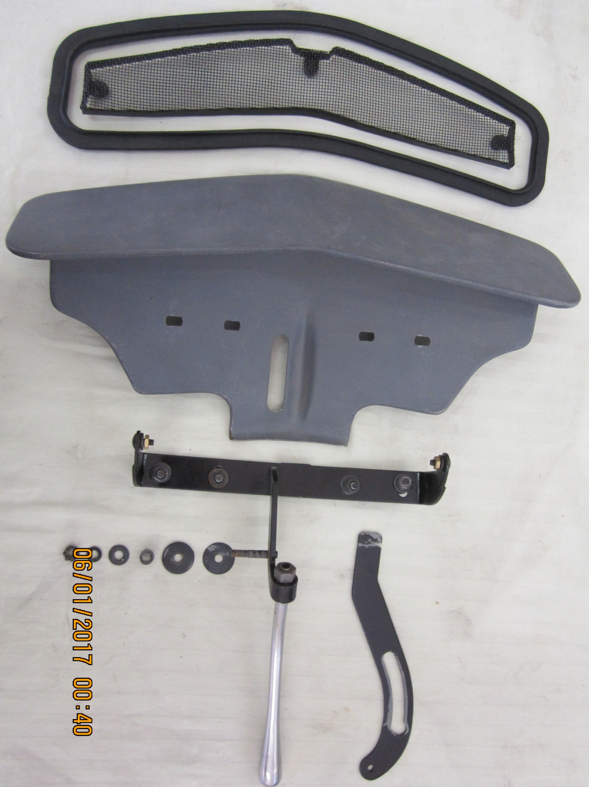
78-700590
(cowl vent screen)
78-700616
(cowl vent rubber seal)
787-700600
(cowl vent )

Slide 2
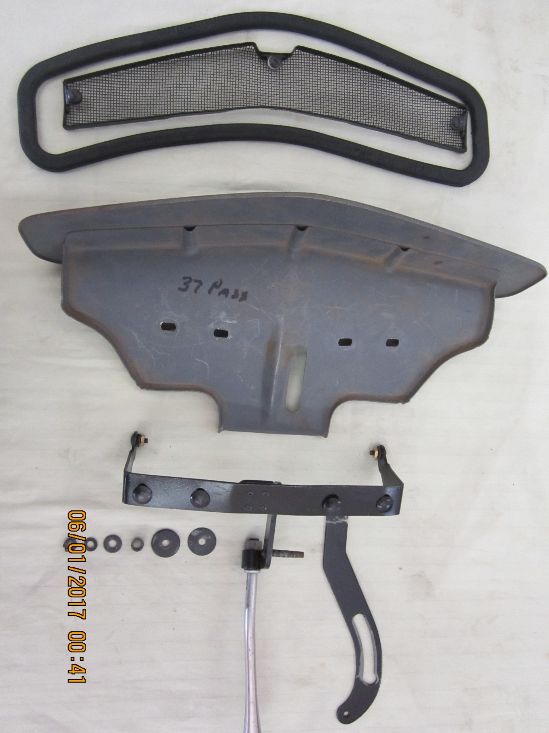

Slide 3
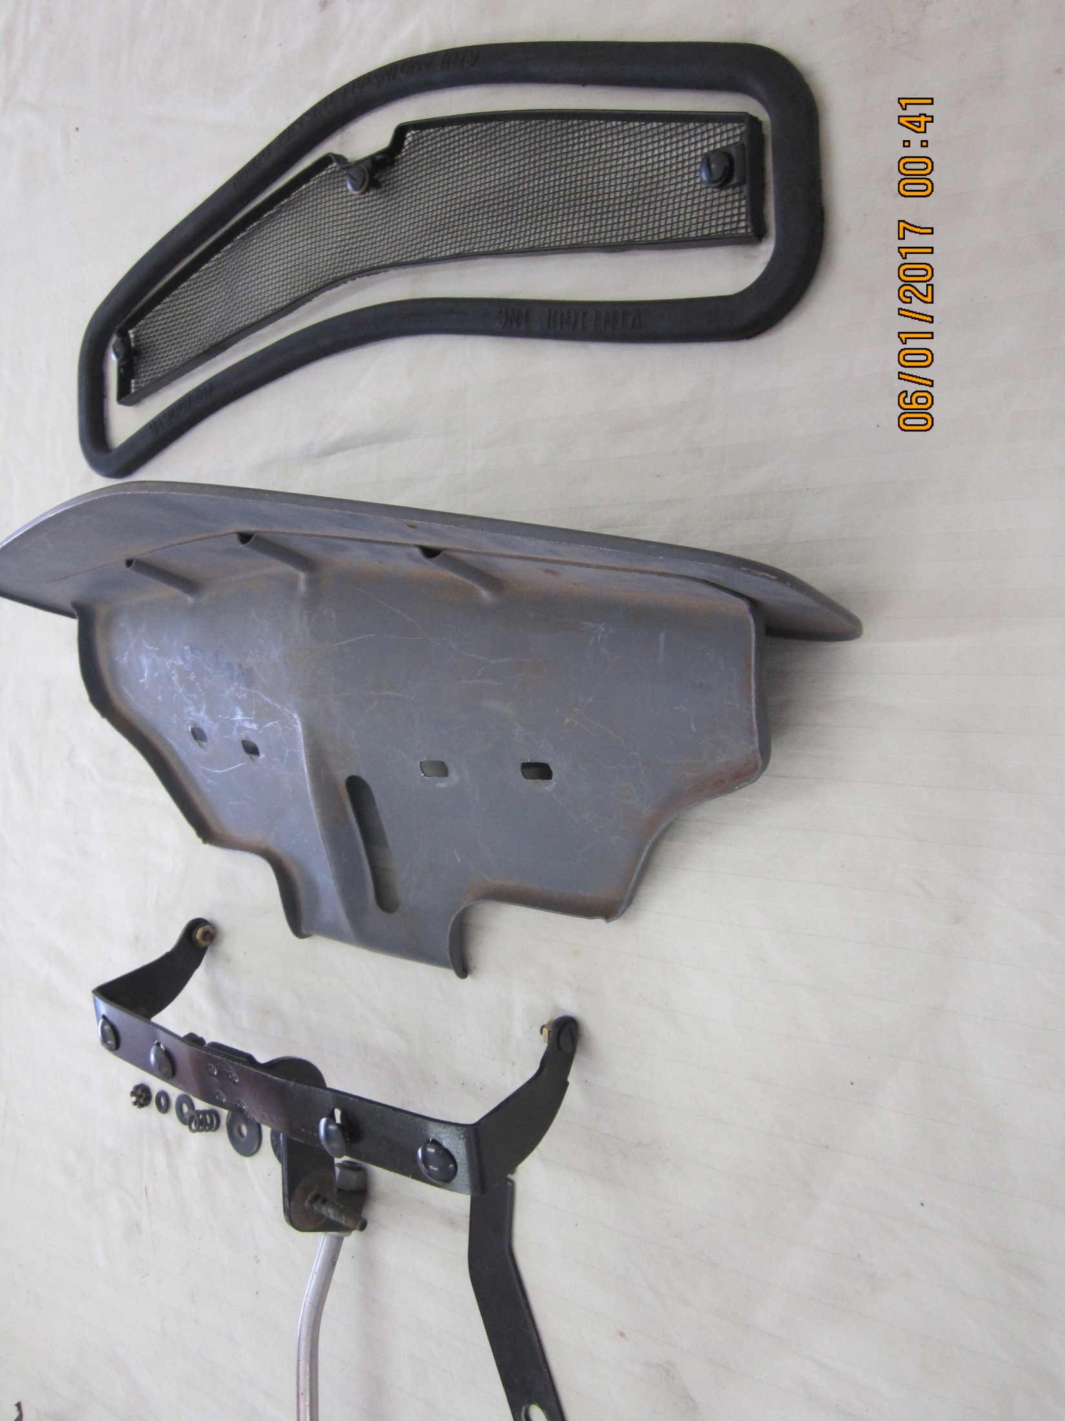

Slide 4
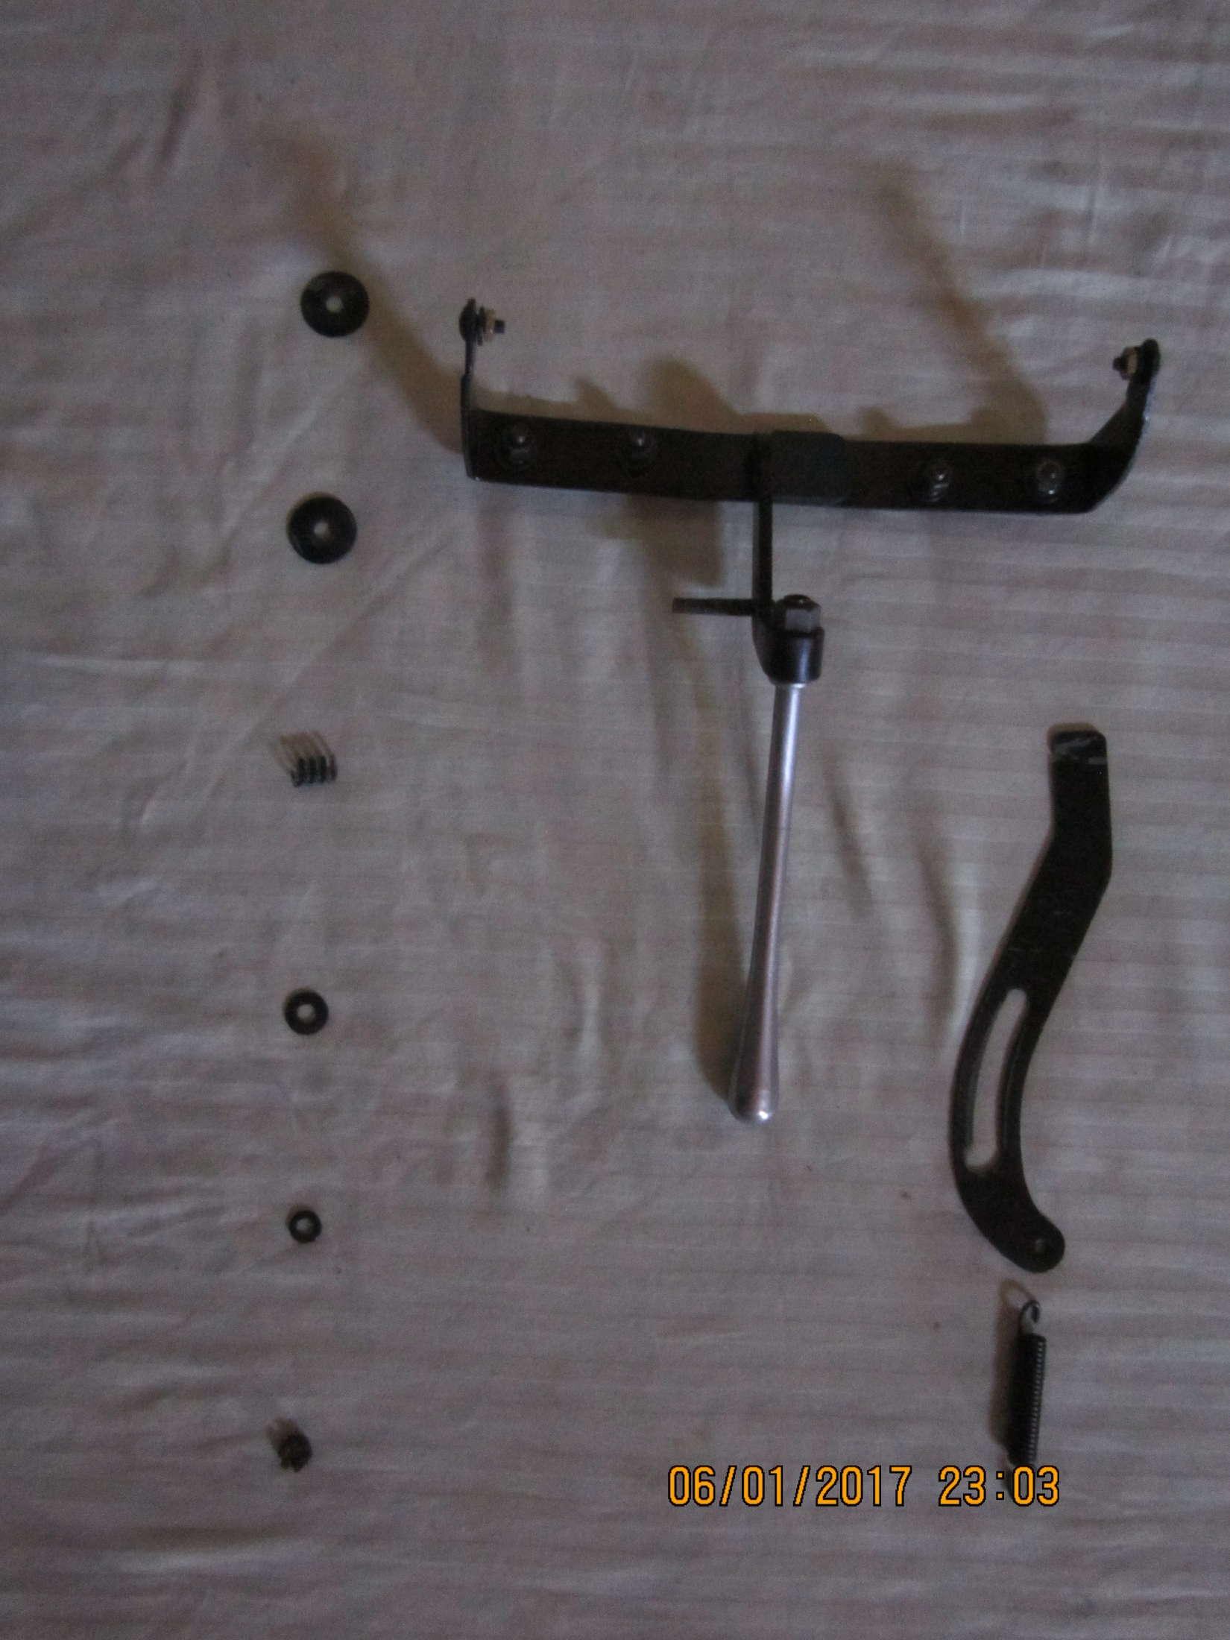
48-700615
(cowl vent lever roller)????
48-700637
(cowl vent friction washer)
787-700600
(cowl vent )
48-700625
(cowl vent washer)
48-700613
(cowl vent mini spring)
78-700620-A
(cowl vent lever ratchet)
48-
(cowl vent washer)
48-
(cowl vent lock washer)
48-
(cowl vent lever nut)
78-700612-A
(cowl vent lever )
40-700624
(cowl vent ratchet spring)

